Slide 1
Design for Reliability
Ensuring Product Performance
Over Time

Slide 2
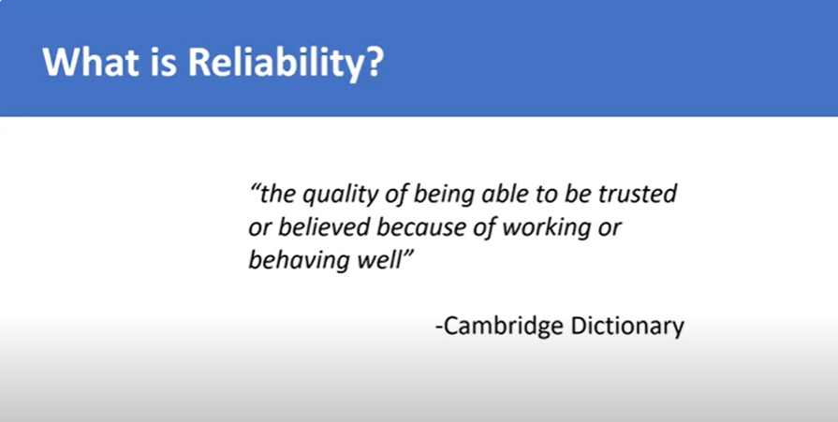


Slide 3
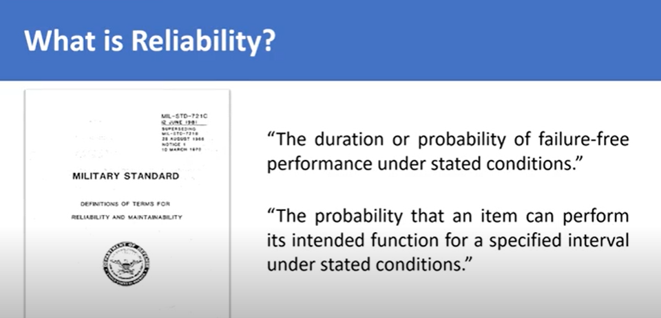
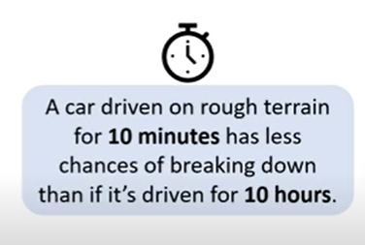

Slide 4
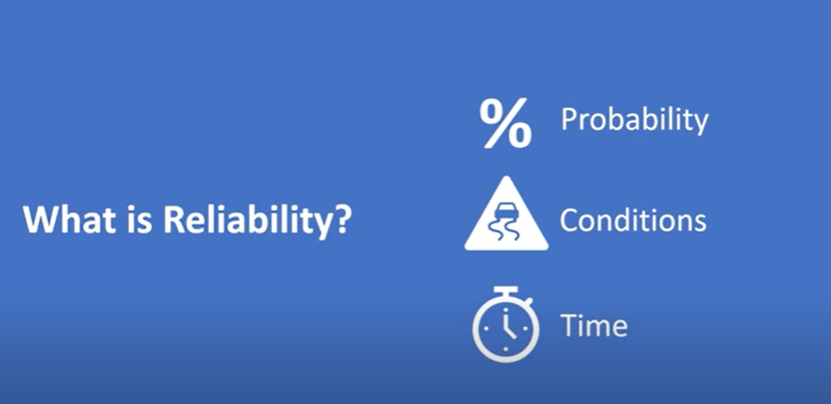
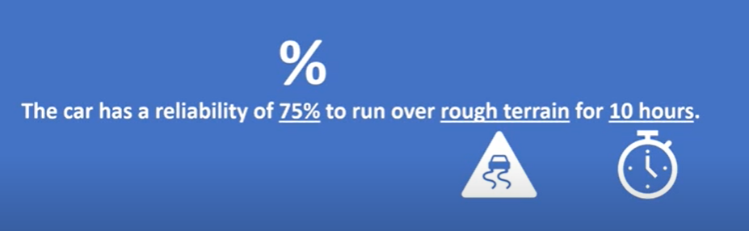

Slide 5
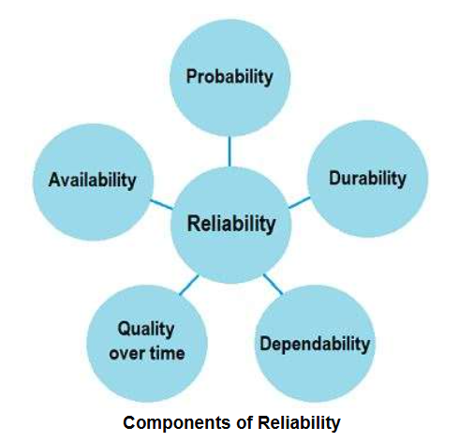
Reliability is defined as the probability that a product, system, or service will perform its intended function adequately for a specified period of time, or will operate in a defined environment without failure

Slide 6
Why Design for Reliability?
Enhances customer satisfaction
Reduces warranty costs
Improves brand reputation
Reduces total lifecycle cost
Ensures safety and compliance

Slide 7
Reliability in Product Life Cycle
Concept Phase: Requirements specification
Design Phase: FMEA, fault-tolerant design
Manufacturing: Process capability, quality control
Operation: Maintenance strategy, failure analysis

Slide 8
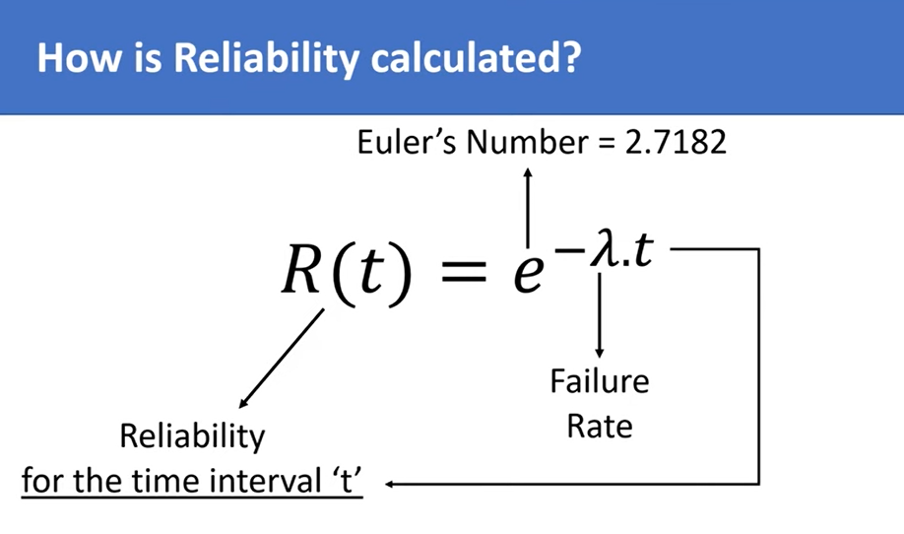

Slide 9
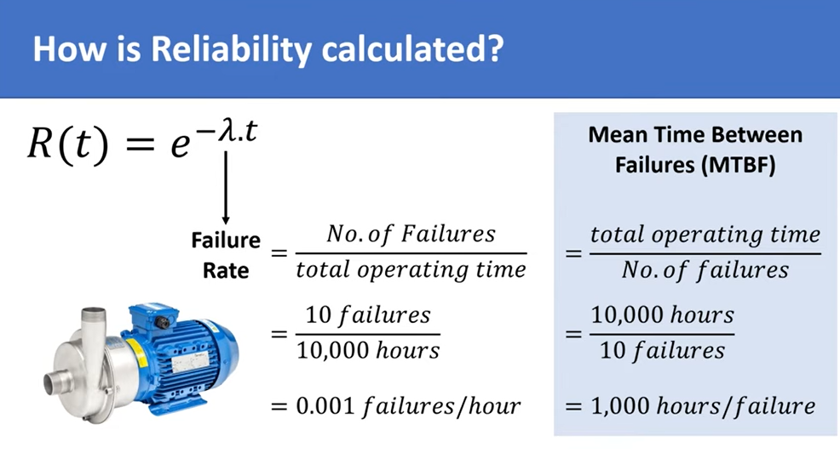

Slide 10
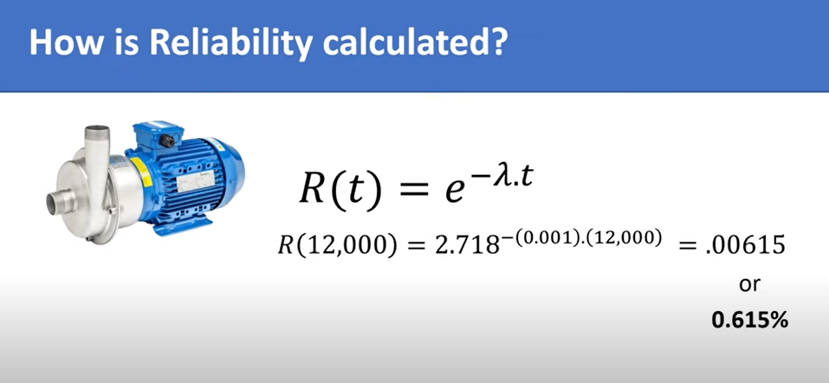
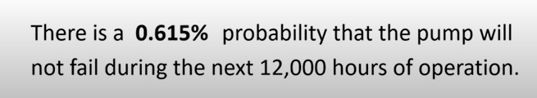

Slide 11
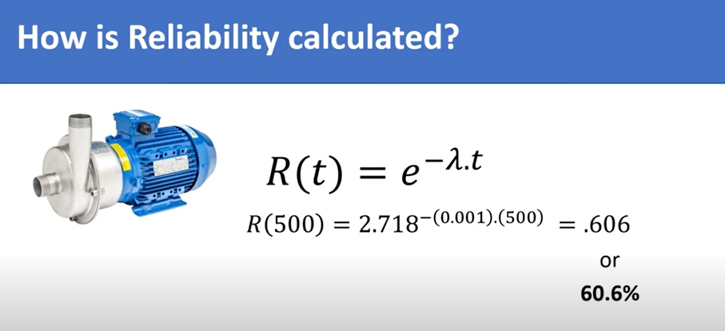

Slide 12
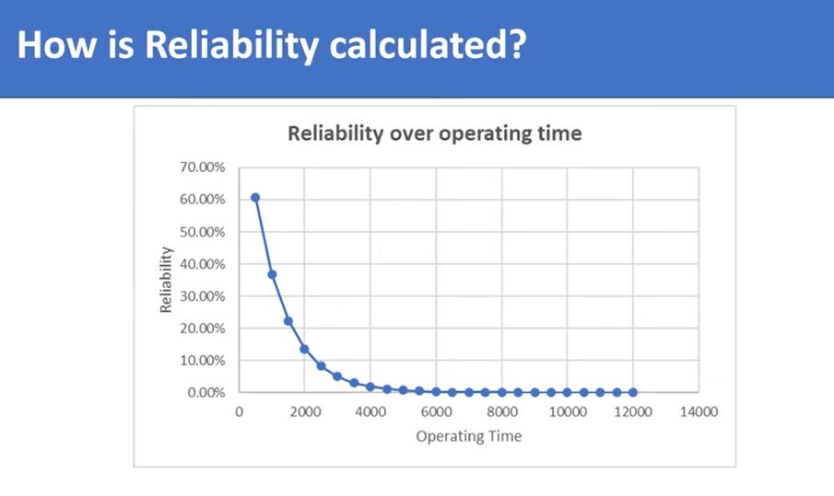

Slide 13
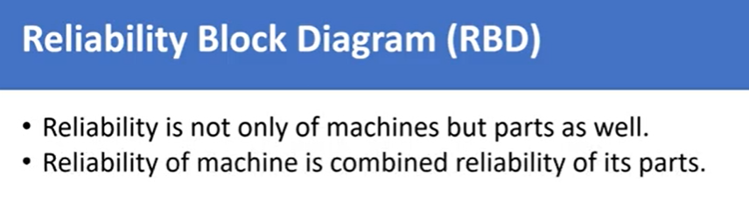
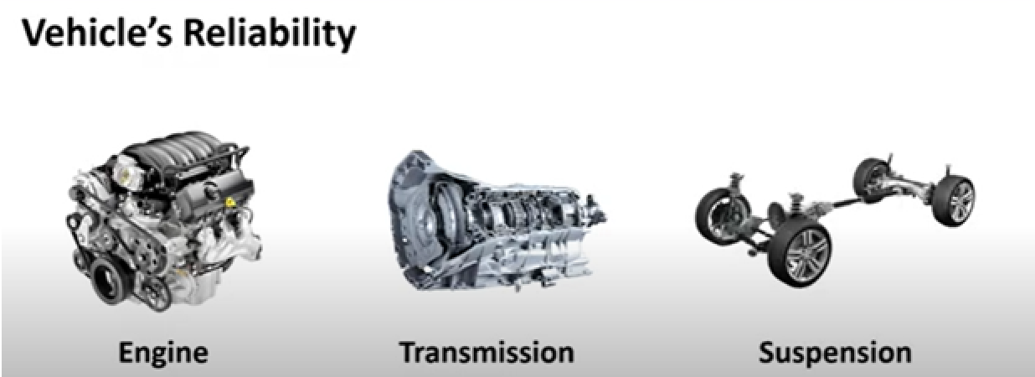
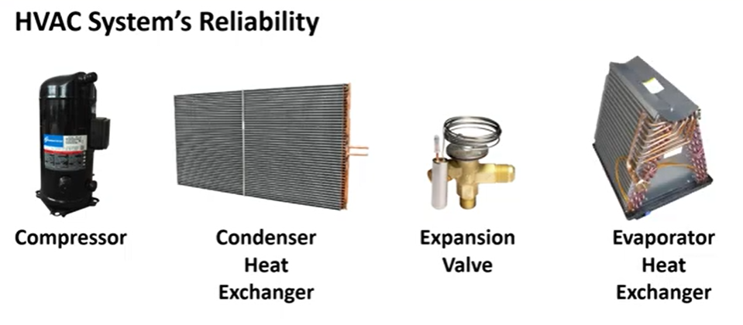

Slide 14
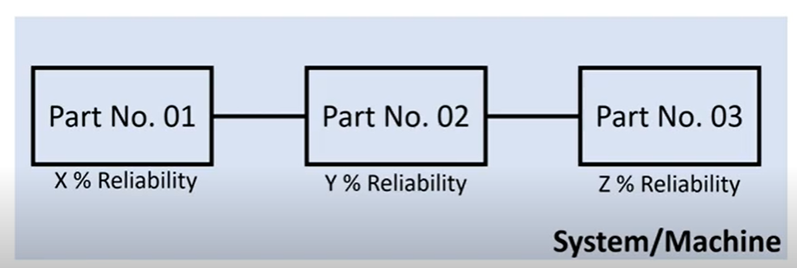
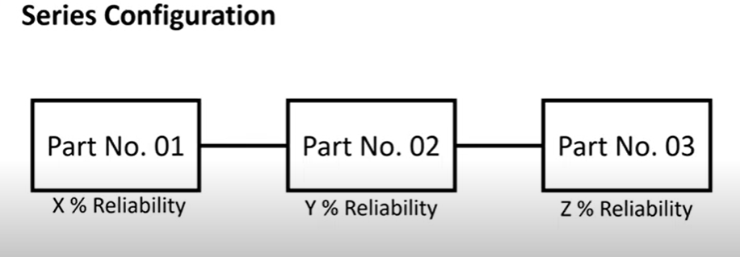
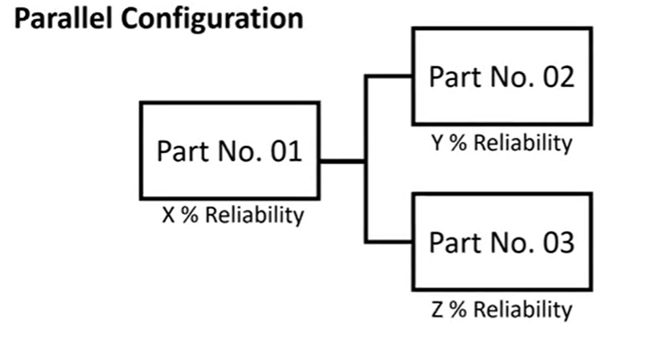

Slide 15
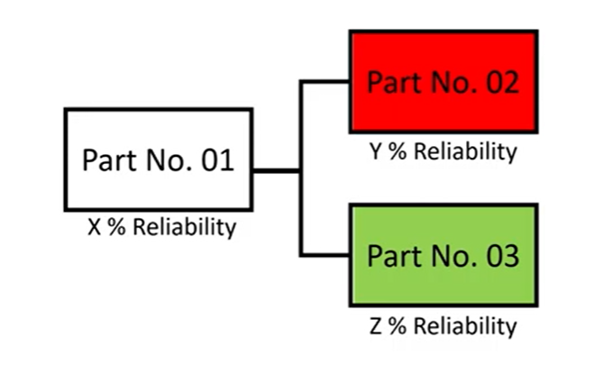
Reliability Calculation

Slide 16
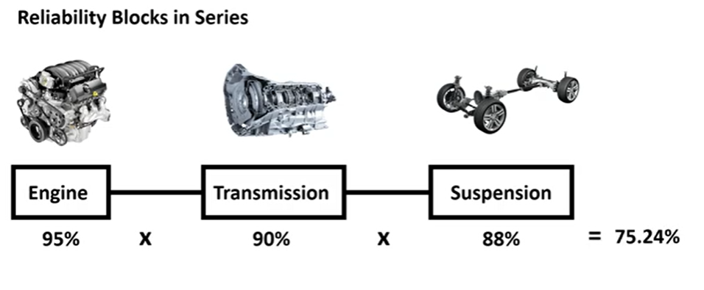
Reliability Calculation

Slide 17
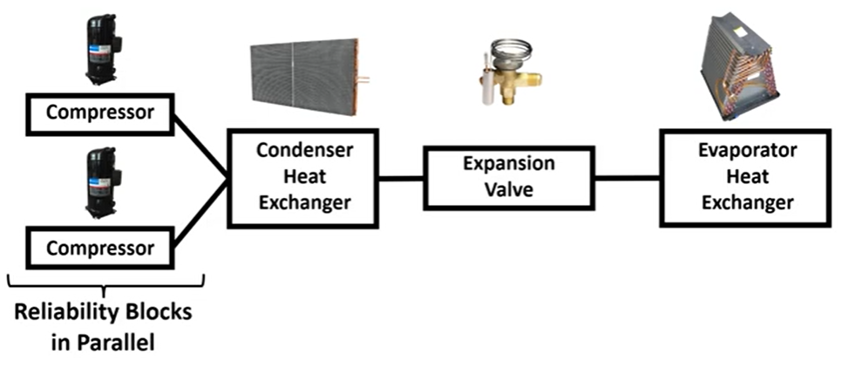
Reliability Calculation

Slide 18
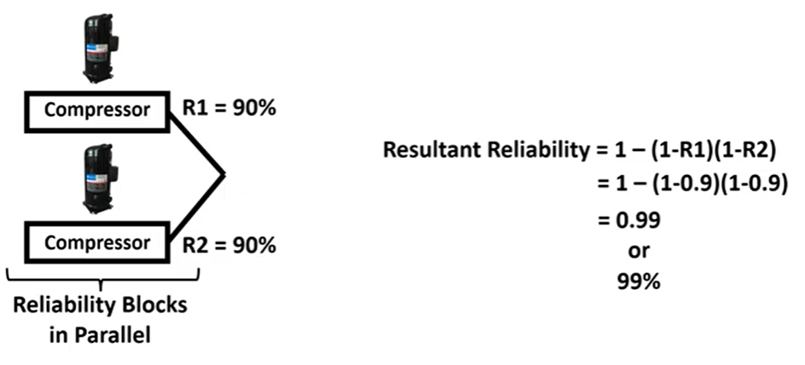
Reliability Calculation

Slide 19
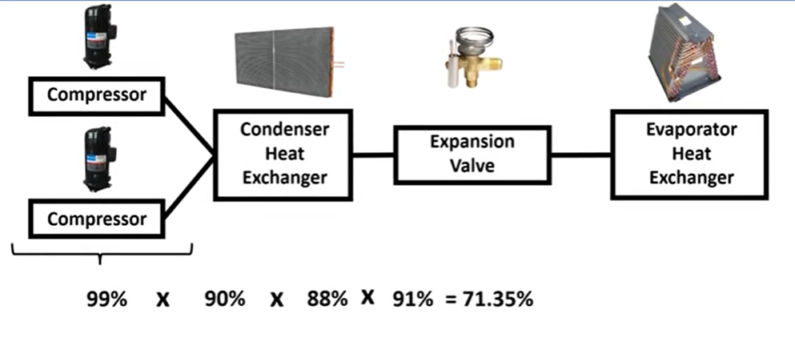
Reliability Calculation

Slide 20
What is Reliability?
Definition: The probability that a product or system performs its intended function without failure for a specified period under stated conditions.
Focus: Long-term performance & failure prevention

Slide 21
Reliability is defined as the probability that a product, system, or service will perform its intended function adequately for a specified period of time, or will operate in a defined environment without failure

Slide 22
Why Design for Reliability?
Enhances customer satisfaction
Reduces warranty costs
Improves brand reputation
Reduces total lifecycle cost
Ensures safety and compliance

Slide 23
Reliability in Product Life Cycle
Concept Phase: Requirements specification
Design Phase: FMEA, fault-tolerant design
Manufacturing: Process capability, quality control
Operation: Maintenance strategy, failure analysis

Slide 24
Design Techniques for Reliability
Redundancy: redundancy refers to the duplication or replication of critical components or functions within a system to enhance reliability and ensure continued operation even if one part fails
Derating: It is the practice of operating electrical and electronic devices at less than their maximum rated capacity to improve reliability and lifespan
Environmental protection
Stress-strength analysis: is a reliability engineering method used to assess the probability of failure in a component or system by comparing the applied stress to its inherent strength
Modular design: Modular design in software engineering is a design principle that involves subdividing a software system into smaller, independent, and interchangeable components called modules. Each module is designed to perform a specific function or set of related functions, and these modules collectively form the complete software system.
Robust design (Taguchi methods): is an approach focused on creating products or processes that perform consistently well, even when faced with variations in manufacturing, usage, or environmental conditions

Slide 25
Difference between quality and reliability
Aspect | Quality | Reliability
Timeframe | At the time of purchase/use | Over a period of time
Measure | Meets specifications and expectations | Performs consistently without failure
Example | A sharp, new LED TV with vibrant colors | A washing machine that works well for 10 years
Focus | Initial features and performance | Long-term dependability
The difference between quality and reliability lies in how a product performs initially versus how it continues to perform over time.

Slide 26
Example: Reliable Web Server System
Imagine you're part of a team that has developed a web server for an e-commerce website.
✅ High Reliability means:
The server runs 24/7 without crashing.
It can handle high user traffic during sales events.
It recovers quickly from minor failures (using redundancy or failover).
It operates for months or years without unexpected downtime.
❌ Low Reliability would be:
The server crashes frequently, requiring restarts.
It lags or becomes unresponsive under moderate load.
Users lose data during transactions.
It needs frequent maintenance or patching to function properly.

Slide 27
Example – Automotive ECU Design
High vibration environment
Use of conformal coating for moisture resistance
Redundant power supplies for fail-safe operation
MTBF target: 100,000 hours
FMEA revealed thermal stress as major issue → Improved heat sinks

Slide 28
Testing for Reliability
Accelerated Life Testing (ALT)
Highly Accelerated Life Testing (HALT)
Burn-in Testing
Environmental Stress Screening (ESS)

Slide 29
Case Study – Smartphone Battery Reliability
Frequent customer complaints on overheating
Root cause: Charging circuit component failure
Solution: Improved thermal pad placement + component derating
Outcome: MTBF improved by 45%

Slide 30
Summary
Reliability is designed, not tested in.
Tools like FMEA and FTA help identify and mitigate failure risks
Robust design ensures long-term performance and customer trust

Slide 31
Key Reliability Concepts
MTTF – Mean Time to Failure (non-repairable items)
MTBF – Mean Time Between Failures (repairable items)
Failure Rate (λ)
Reliability Function (R(t))

Slide 32
MTBF (Mean Time Between Failures)
MTBF is a key reliability metric used to predict the average time between system failures for repairable systems.

